Slide 1
CSET301 – AI-ML
Lecture 26 : PCA

Slide 2
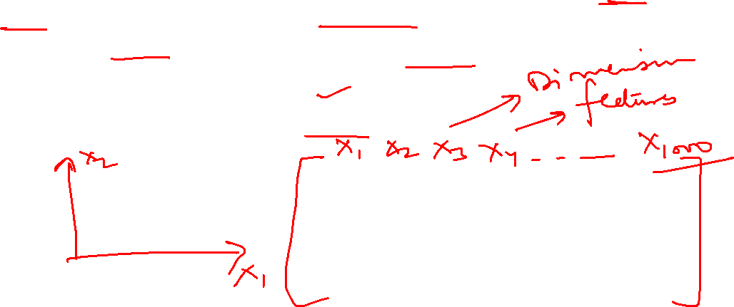
Principal Component Analysis (PCA)
Principal component analysis (PCA) is a mathematical technique used in data analysis and statistics. It is designed to simplify complex data sets by transforming them into a more manageable form while retaining the most critical information.
Reducing the dimensionality of data set
Increasing interpretability without losing information

Slide 3

Dimensionality reduction
Dimension reduction (DR) refers to techniques that reduce the number of input variables in a data set.
Why DR?
Less dimensions means less computation or training time
Redundancy is removed after removing similar entries from data set
Reduce the number of variables by merging correlated variables
Data compression (reduce storage space)
Helps find out most significant features
Leads to better human interpretations
It can be divided into feature selection and feature extraction.
  – Feature selection approaches try to find a subset of the original variables (also called features or attributes).
  – Feature projection or Feature extraction transforms the data in the high-dimensional space to a space of fewer dimensions.

Slide 4

Principal Component Analysis (PCA)
Principal component analysis, or PCA, is a statistical technique to convert high dimensional data to low dimensional data by selecting the most important features
that capture maximum information about the dataset.
• The features are selected on the basis of variance that they cause in the output.
• The feature that causes highest variance is the first principal component. The feature that is responsible for second highest variance is considered the second principal
component, and so on.
• It is important to mention that principal components do not have any correlation with each other.

Slide 5

Why PCA?
Dimensionality reduction
Noise reduction
Visualization
Feature Engineering
Overfitting problem
Data compression

Slide 6

Important terminologies
Variance
Covariance
Eigen values
Eigen vectors
Principal Component

Slide 7

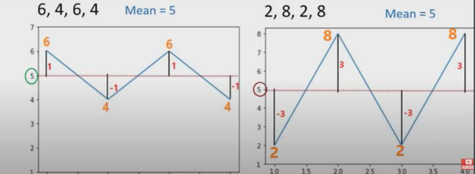
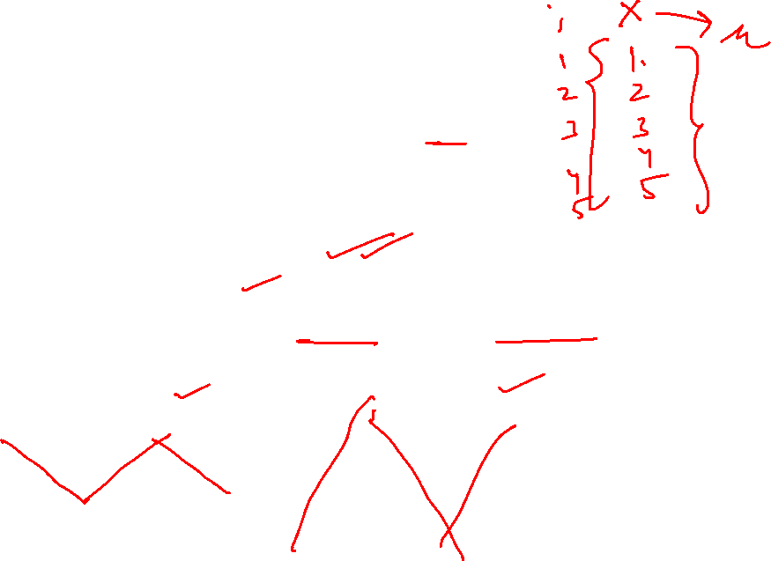
Variance
Sum of squares of differences between all numbers and means
Variance (𝜎²): Sum of the squared differences from the mean / Total values
Variance is the measure that indicates how much data is scattered around the mean

Slide 8

CoVariance
It is the relationship between a pair of random variables where change in one variable causes change in another variable
Can take any value between –inf to +inf, where negative value represents the negative relationship and positive value represents positive relationship.
Used for linear relationship between variables
Gives the direction of relationship between variables.

Slide 9

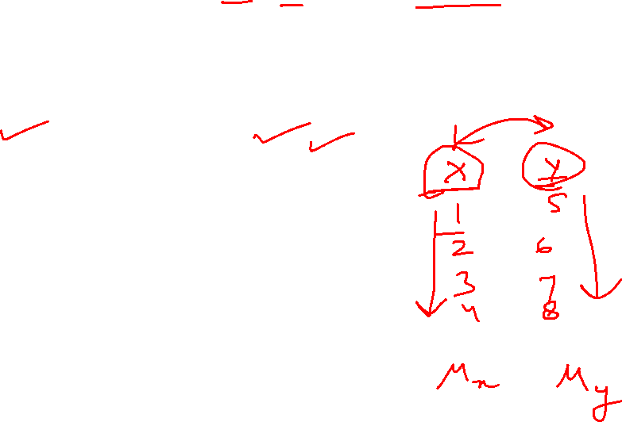
CoVariance
Covariance between two random variables X and Y, each with N data points can be shown as:

Slide 10
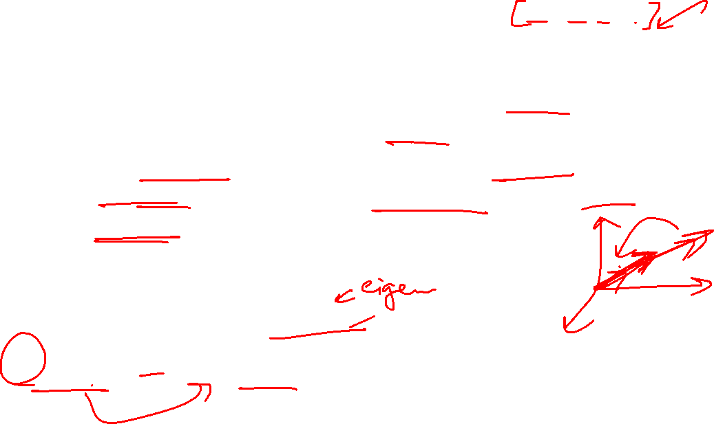
Eigen values and Eigen vectors
Eigenvalues and eigenvectors are fundamental concepts in linear algebra used to analyze linear transformations represented by square matrices.
An eigenvector is a non-zero vector that, when a linear transformation is applied, does not change its direction, but is instead scaled by a scalar factor. This scaling factor is the eigenvalue.
The relationship is defined by the equation:
Ax = λx
Where A is the matrix, x is the eigen vector, and λ is the corresponding eigenvalue

Slide 11

Eigen vectors
A non-zero vector that, after a linear transformation, points in the same or opposite direction as the original vector.
Represents a direction that is invariant under the transformation, meaning the transformation only scales the vector, it doesn't rotate or shear it.

Slide 12

Steps in PCA
Standardization: PCA requires standardized data, so the first step is to standardize the data to ensure that all variables have a mean of 0 and a standard deviation of 1.
Calculate the covariance matrix: The next step is to calculate the covariance matrix of the standardized data. This matrix shows how each variable is related to every other variable in the dataset.
Calculate the eigenvectors and eigenvalues: The eigenvectors and eigenvalues of the covariance matrix are then calculated. The eigenvectors represent the directions in which the data varies the most, while the eigenvalues represent the amount of variation along each eigenvector.
Choose the principal components: The principal components are the eigenvectors with the highest eigenvalues. These components represent the directions in which the data varies the most and are used to transform the original data into a lower-dimensional space.
Transform the data: The final step is to transform the original data into the lower-dimensional space defined by the principal components.

Slide 13

Standardization
The aim of this step is to standardize the range of the continuous initial variables so that each one of them contributes equally to the analysis.
• It is critical to perform standardization prior to PCA, since it is quite sensitive regarding the variances of the initial variables.
• That is, if there are large differences between the ranges of initial variables, those variables with larger ranges will dominate over those with small ranges

Slide 14

Standardization
• Mathematically, this can be done by subtracting the mean and dividing by the standard deviation for each value of each variable.
• Once the standardization is done, all the variables will be transformed to the same scale.

Slide 15
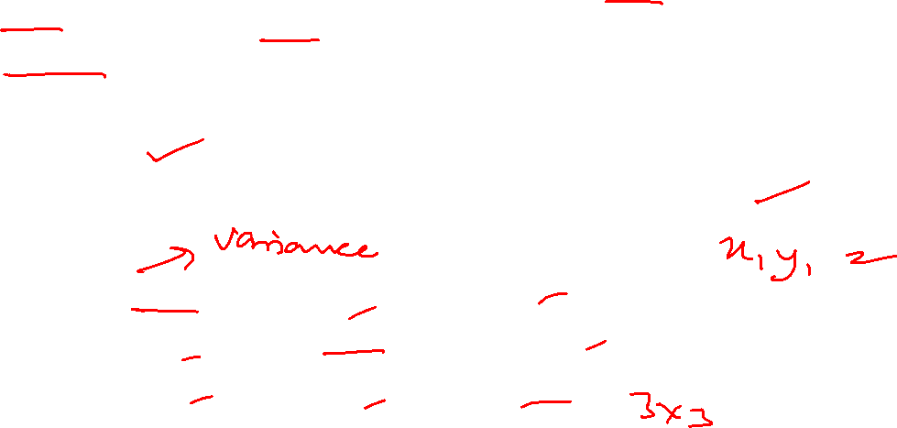
Covariance matrix computation
The aim of this step is to understand how the variables of the input data set are varying from the mean with respect to each other, or in other words, to see if there is any relationship between them.
• Because sometimes, variables are highly correlated in such a way that they contain
redundant information.
• So, in order to identify these correlations, we compute the covariance matrix.

Slide 16

Covariance matrix computation
Covariances tell us about the correlations between the variables
It’s actually the sign of the covariance that matters :
  – if positive then : the two variables increase or decrease together (correlated)
  – if negative then : One increases when the other decreases (Inversely correlated)
Covariance matrix is a table that summaries the correlations between all the possible pairs of variables

Slide 17

Principal Components
• Principal components are new variables that are constructed as linear combinations or mixtures of the initial variables.
• These combinations are done in such a way that the new variables (i.e., principal components) are uncorrelated and most of the information within the initial variables is squeezed or compressed into the first components.
• So, the idea is 10-dimensional data gives you 10 principal components, but PCA tries to put maximum possible information in the first component, then maximum remaining information in the second and so on

Slide 18
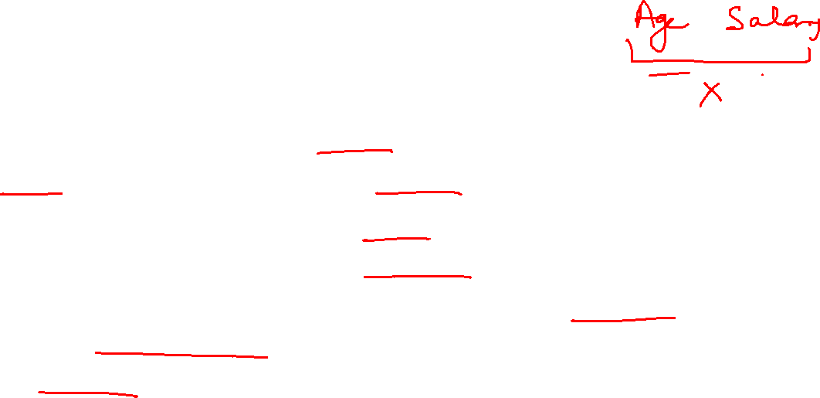
Principal components
• Organizing information in principal components this way allows to reduce dimensionality without losing much information, by discarding the components with low information and considering the remaining components as your new variables.
• Note: The principal components are less interpretable and don’t have any real meaning since they are constructed as linear combinations of the initial variables.
• Geometrically speaking, principal components represent the directions of the data that explain a maximal amount of variance, that is to say, the lines that capture most
information of the data.

Slide 19

Principal components
For example, let’s assume that the scatter plot of our data set is as shown here, can we guess the first principal component?
• Yes, it’s approximately the line that matches the purple marks because it goes through the origin and it’s the line in which the projection of the points (red dots) is the most spread out.
• Or mathematically speaking, it’s the line that maximizes the variance (the average of the squared distances from the projected points (red dots) to the origin).

Slide 20
Thank You

